Slide 1

Pattern Mining project
Professors: Ahmed Samet, Samer El Zant
Students: Elnur Maharramov, Parvin Bayramov, Mirhashim Seyidov

Slide 2
Data Mining Project
Literature review: General information about Data Mining and the dataset
Data imputation: Data cleaning and preparation process
Exploratory Data Analysis: Gaining a better understanding of the dataset
Feature Selection and Engineering: Selecting and engineering relevant features
Classification: Building a model using data mining techniques
Evaluation: Evaluating the performance of the model
The Results: Compare results between different models

Slide 3
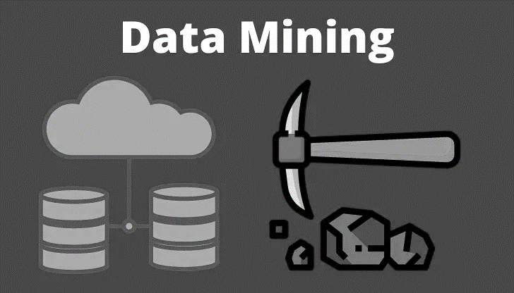
What is Data Mining?
Definition of data mining
Data mining's application in various fields
Steps involved in data mining
Description of the dataset
18 attributes and 199 entries
Objective of the project

Slide 4
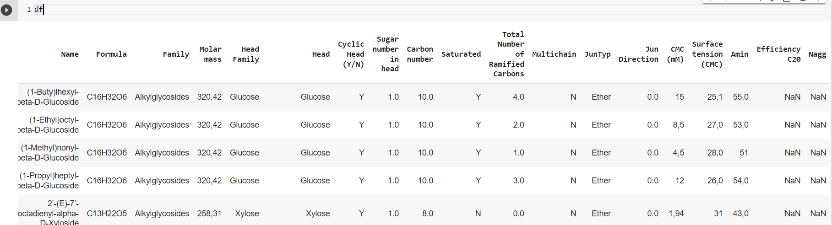
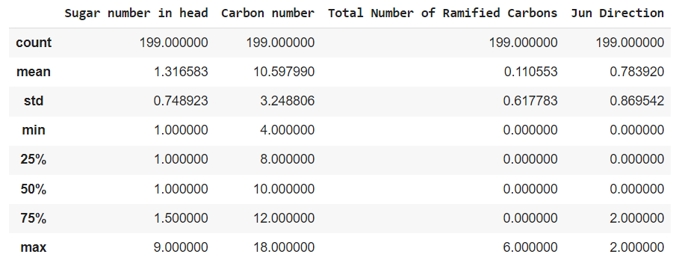
Data Cleaning and Preparation
Importing the dataset into Google Colab
Libraries used for data imputation
Fixing errors while loading the dataset
Identifying and removing duplicate rows
Obtaining a concise summary of the dataset
Identifying potential data quality issues
Understanding the data types of each column

Slide 5
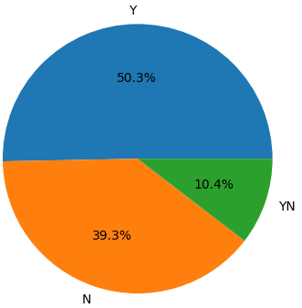
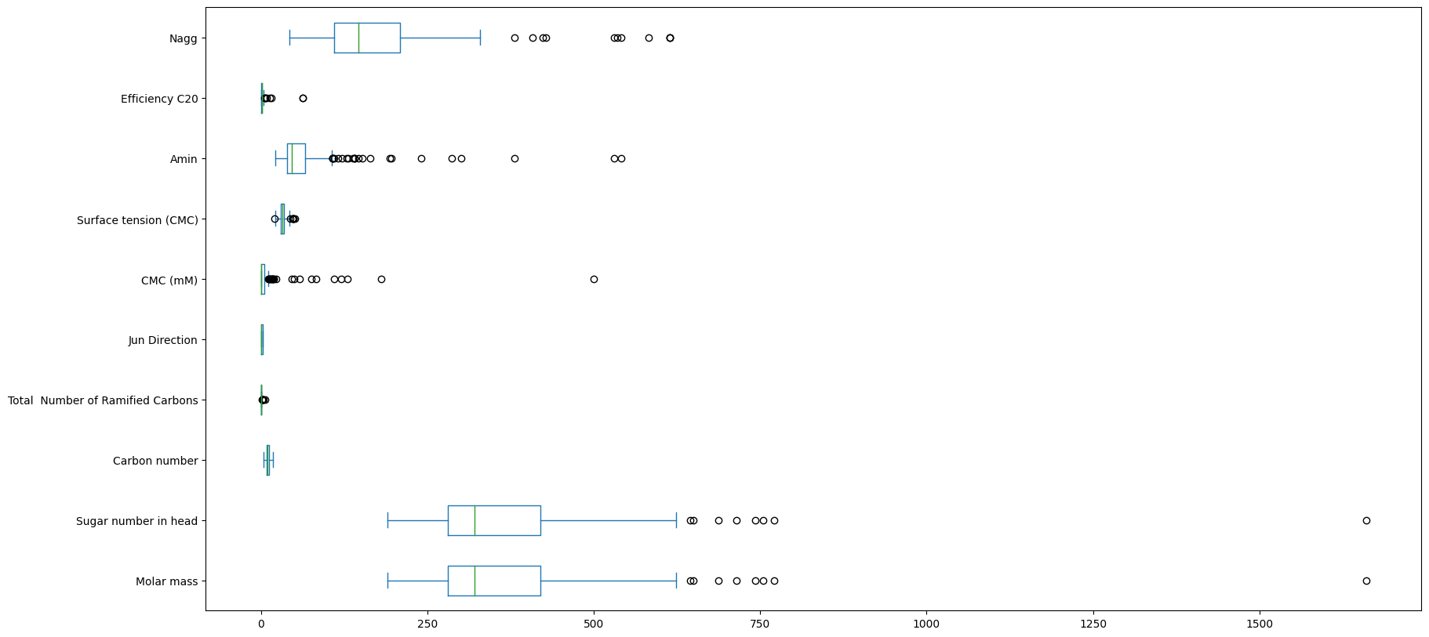
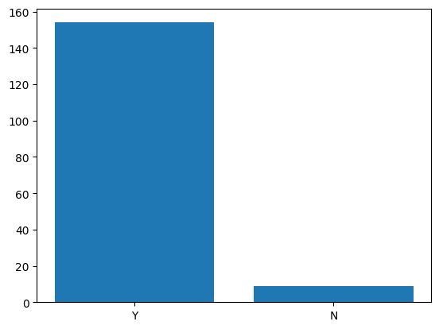
Exploring the Dataset
Visualizing the distribution of the columns
Identifying outliers
Checking the correlation between columns Title: Handling Null Values
"Cyclic Head (Y/N)“ column
“Saturated” column

Slide 6
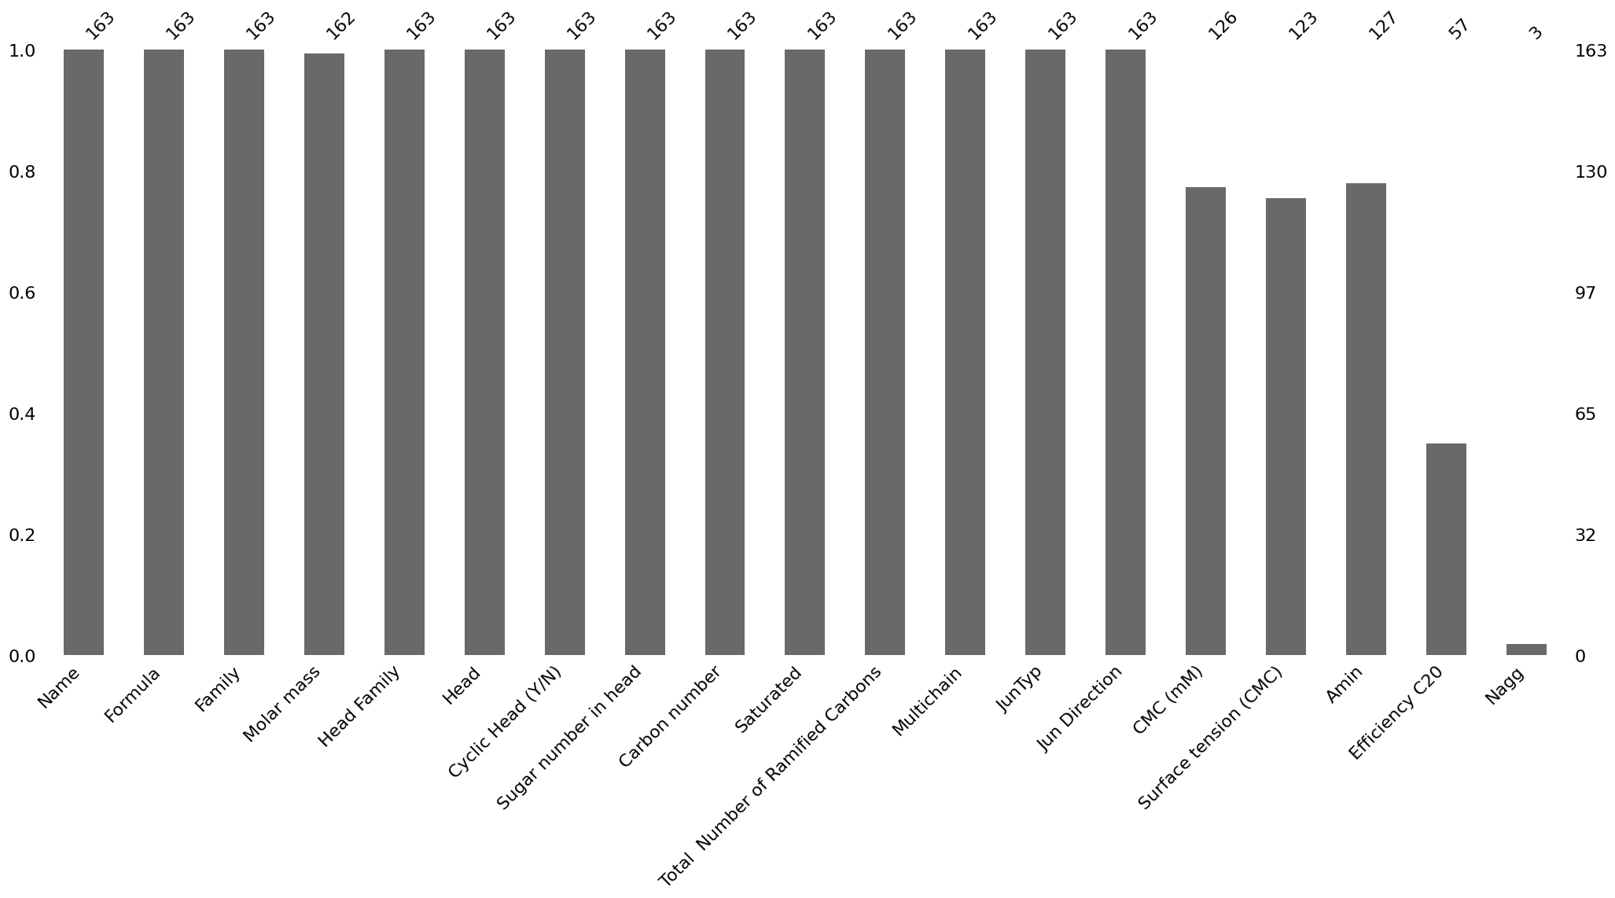
Identifying columns with null values
Imputing null values using various techniques

Slide 7
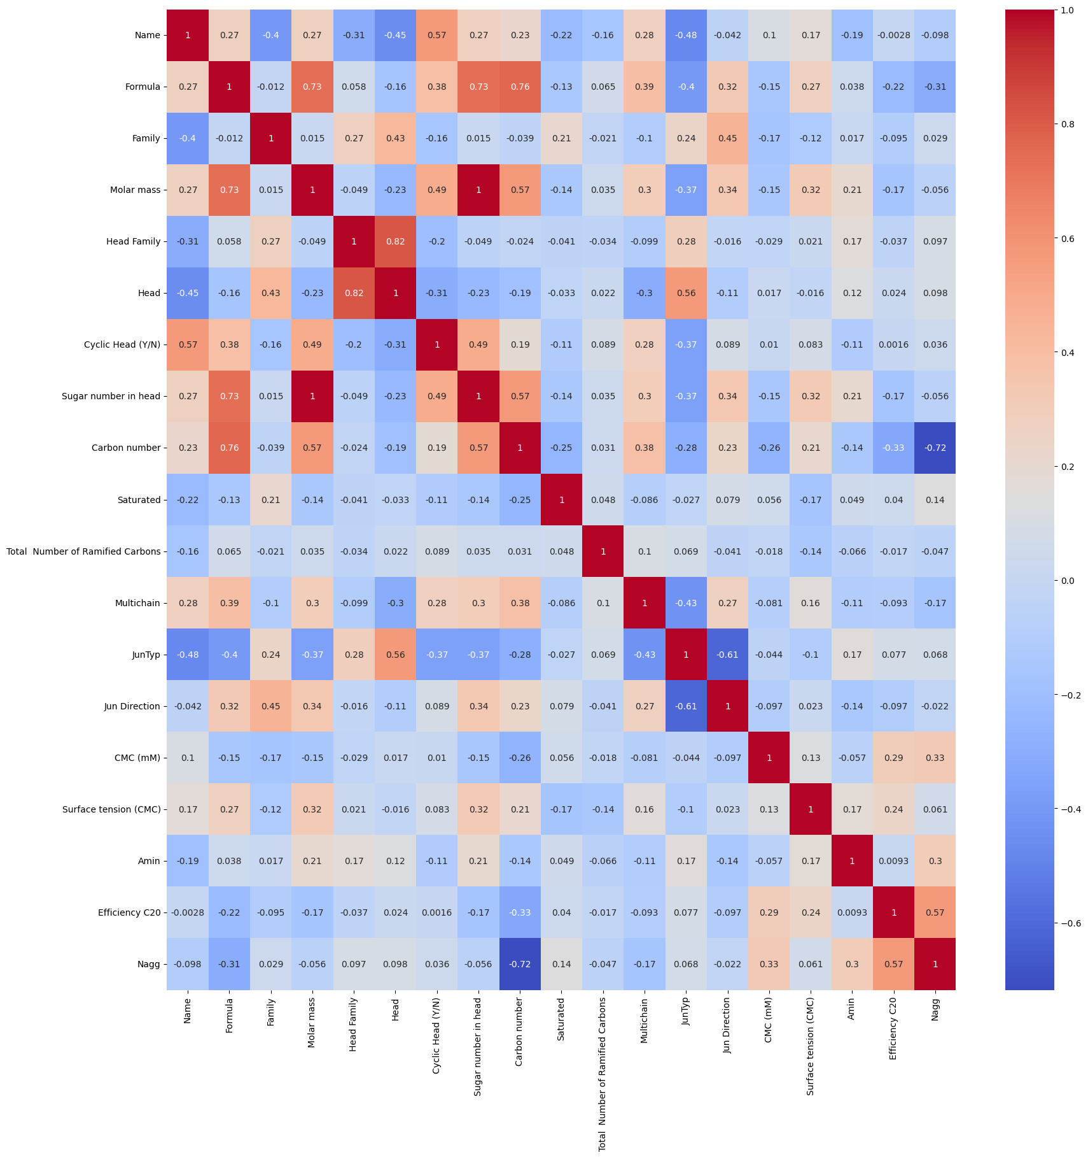
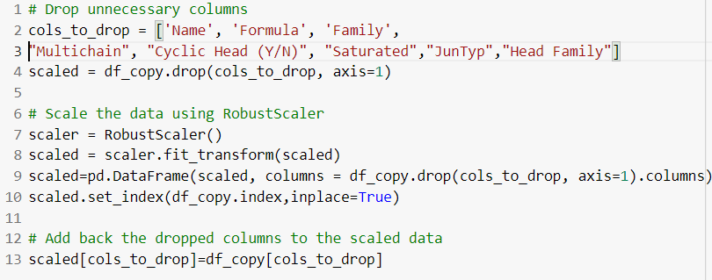

Selecting Relevant Features
Identifying important features using correlation matrix
Selecting features based on instruction
Scaling the numerical features
Encoding categorical features

Slide 8
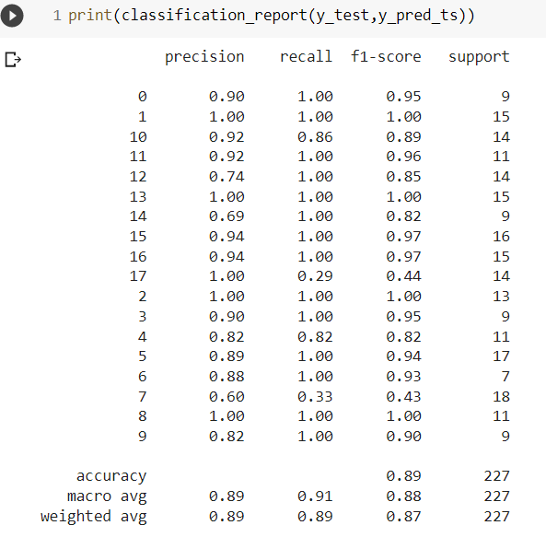
Building a Model
Classification report for Decision tree classifier model
Splitting the dataset into training and testing sets
Choosing the appropriate algorithm
Tuning hyperparameters using GridSearchCV Title: Model Performance
Evaluating the performance of the model
Comparing the actual and predicted values
Printing the accuracy and other metrics

Slide 9
the Results
Results before hyper parameters tuning
Model | Train score | Test score
DecisionTreeClassifier | 99.6% | 88.5%
RandomForestClassifier | 99.6% | 88.1%
SVC | 93.1% | 80.6%
KNeighborsClassifier | 88.8% | 73.1%
Results after hyper parameters tuning
Model | Best score
DecisionTreeClassifier | 91.8%
RandomForestClassifier | 91.6%
SVC | 85.06%
KNeighborsClassifier | 90.7%

Slide 10
Conclusion
In conclusion, this project used data mining techniques to explore a chemical dataset and extract valuable insights and knowledge. The project involved data cleaning and preparation, exploratory data analysis, feature selection and engineering, classification, and compare the results.

Slide 11


Thanks for your attenTion

